Slide 1
Opening a Vegan Restaurant in London
A data analysis approach to select the best districts in London where to open a plant-based eating out option

Slide 2
Contents
Introduction
Data Acquisition and Preliminary Analysis
Methodology
Results
Conclusion
References

Slide 3
Introduction
Healthy food has become a trending topic in the past few years. People are paying more attention to what they eat, and how they eat. Several consumers are changing their habits from animal derived goods to plant-based goods, and the interest has increased significantly in the United Kingdom.

Slide 4

Introduction
The UK's purchase and consumption rates of vegan: milk, meat, butter/margarine, cheese, ready meals/food to go and seafood are the highest in Europe.
In 2018, the UK launched more vegan products than any nation.
Between November 2019 and November 2020, vegan food orders via Deliveroo shot up 115%.
Demand for meat-free food in the UK increased by 987% in 2017 and going vegan was predicted to be the biggest food trend in 2018.
The Google Trends on veganism puts the UK as the fourth region with more interest in the subject, and shows the increase in search of veganism consistently rising since 2013.

Slide 5
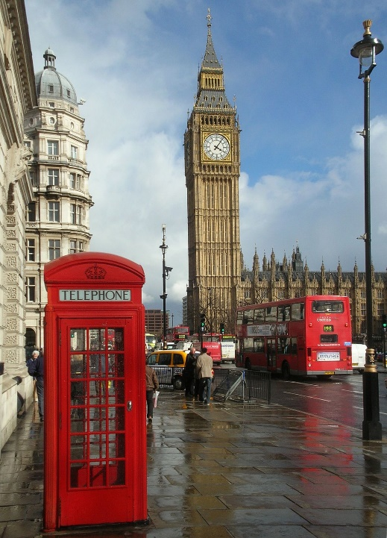
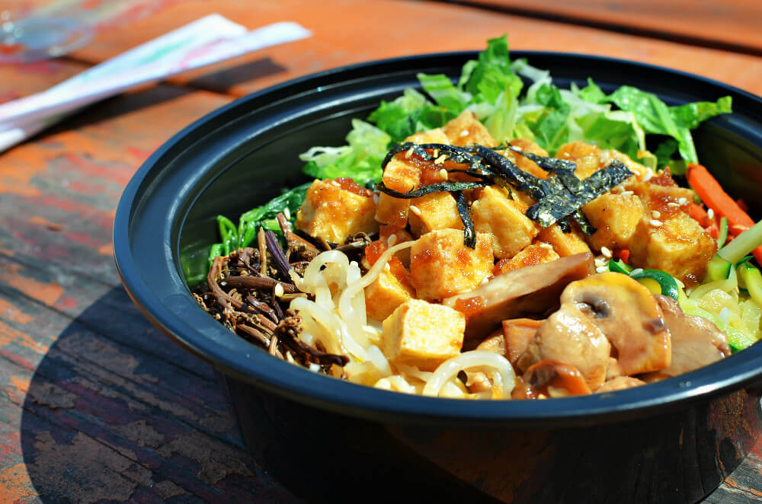

Introduction
Goal:
Find which districts of London are the best choices to open a new vegan restaurant.

Slide 6
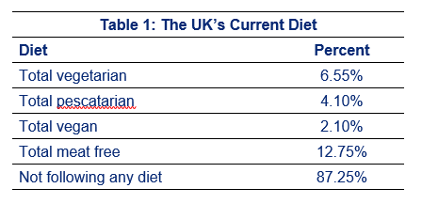
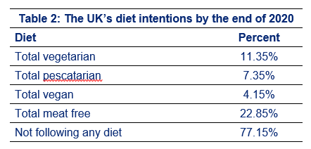
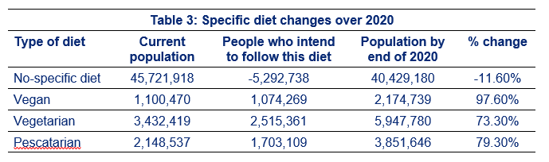
Data Acquisition and Preliminary Analysis

Slide 7
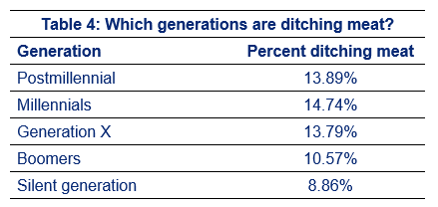
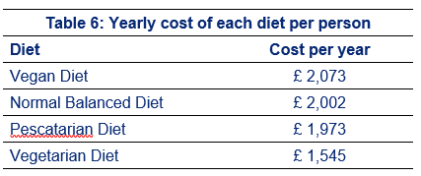
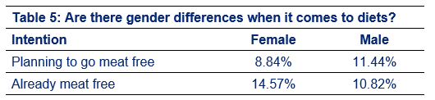
Data Acquisition and Preliminary Analysis

Slide 8
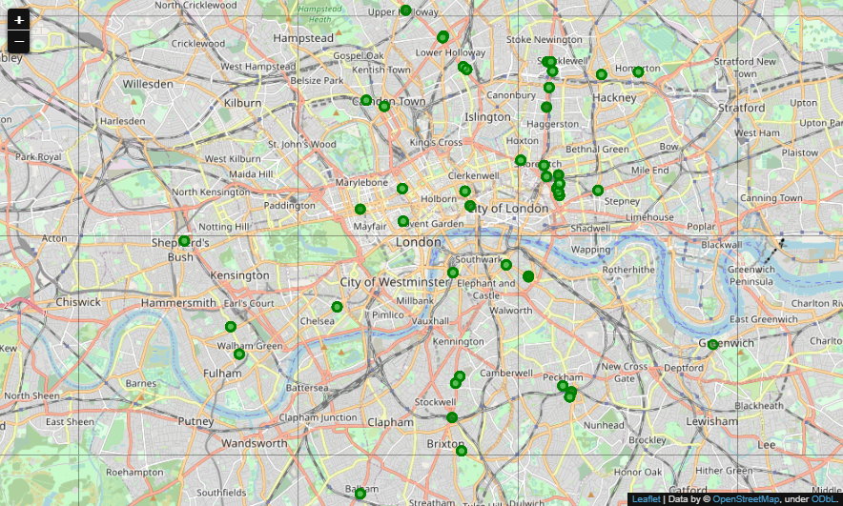
Data Acquisition and Preliminary Analysis
Map with the existing Vegetarian / Vegan Restaurants in London

Slide 9
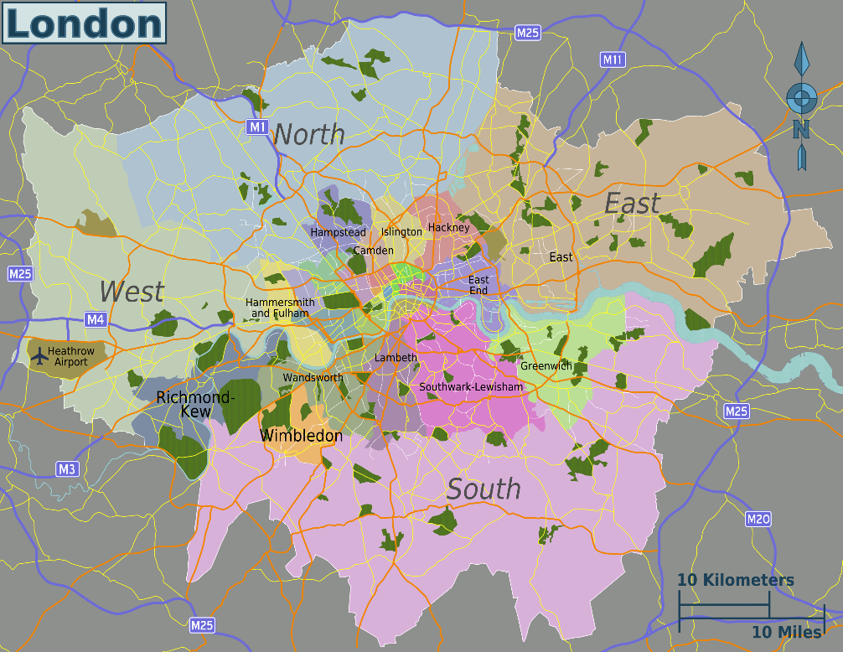
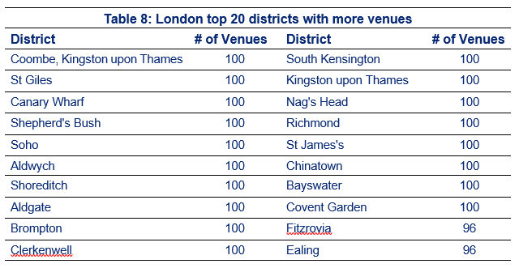
Methodology
Get all districts in Greater London
Total: 527
Top 20 districts with more venues:

Slide 10
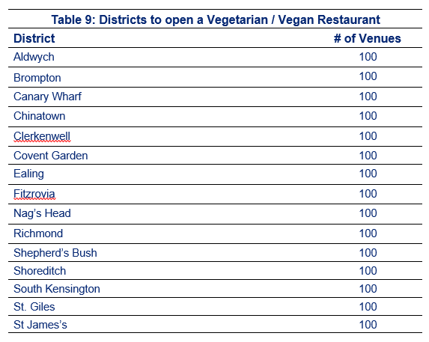
Methodology
Finding the best districts for business:

Slide 11
Results
From our initial 527 districts of London that were evaluated, we were able to retrieve 15 where one can find lots of venues (and lots of people), but do not have an option for plant-based food.

Slide 12
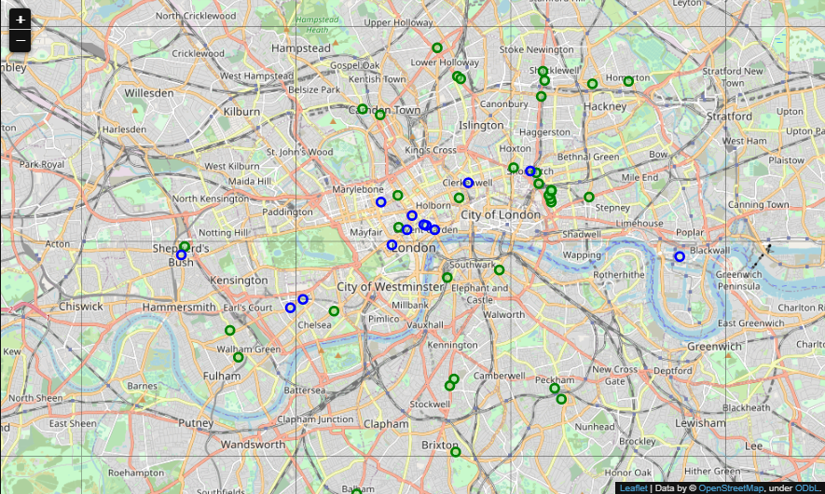
Results
Blue dots:
hot districts
Green dots:
competition
First districts to further explore:
Covent Garden, Brompton and South Kensington.

Slide 13

Conclusion
This simple analysis reveals the power of data analysis to help businesses achieve their goals. We started looking at the whole city of London, and finished looking to 14 districts that seem more promising, and even getting the first three on where to start using visualisation tools.
There is room for a more detailed analysis, which requires more work, and we can even get to the best streets where to open our restaurant. But I need to keep working, so this will be for another time.

Slide 14
References
[1] https://www.vegansociety.com/news/media/statistics#vegandietintheuk
[2] https://proveg.com/what-we-do/corporate-engagement/proveg-consumer-survey-report-download/
[3] https://www.mintel.com/press-centre/food-and-drink/veganuary-uk-overtakes-germany-as-worlds-leader-for-vegan-food-launches
[4] https://www.casualdiningmagazine.co.uk/news/2020-10-29-vegan-orders-surge-more-than-100-in-12-months
[5] https://plantbasednews.org/lifestyle/2017-ridiculous-987-increase-demand-meat-free-options/
[6] https://trends.google.com/trends/explore?date=all&q=%2Fm%2F07_hy
[7] https://www.finder.com/uk/uk-diet-trends
[8] https://en.wikipedia.org/wiki/Greater_London
[9] https://plantproteins.co/vegan-plant-based-diet-statistics/
[10] https://foodrevolution.org/blog/vegan-statistics-global/
[11] https://healthcareers.co/vegan-statistics/
[12] https://www.forbes.com/sites/janetforgrieve/2018/11/02/picturing-a-kindler-gentler-world-vegan-month/?sh=34e448e22f2b

